Slide 1
SEC555
Presentation based on SEC555: SIEM with Tactical Analytics
Unconventional Logging and Detection
Justin Henderson (@SecurityMapper)

Slide 2
About Me
Justin Henderson
SEC555 Author / SEC455 and SEC530 Co-Author
GSE #108 / Cyber Guardian Blue + Red / 60 certs
Owner and Principal Consultant of H & A Security Solutions
Twitter: @SecurityMapper
GitHub: github.com/HASecuritySolutions
And security hobbyist and community supporter
Collecting interns/contributors in bulk (research teams)
Release research to the community

Slide 3
Unconventional Tactics
Log Collection
Detection
Focus on picking up logs
Without requiring agents on each endpoint
Or without agents entirely
Upgrading logs
Adding context (log enrichment)
Methods work regardless of SIEM in use
Implement detection capabilities
Without requiring security software or agents
Remove requirement for remote polling software
osquery
SSH
WMI

Slide 4


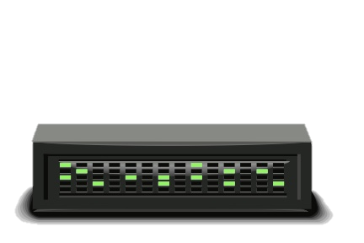
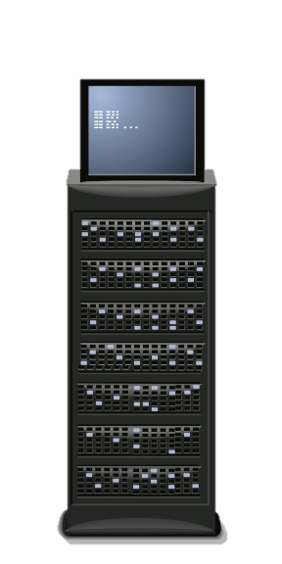
Log Agents
Remote Site Central Location
Internet
agent
agent
Storage
syslog
VPN Tunnel
Log Aggregator
agent

Slide 5
Windows Event Forwarding
To collect logs using Windows event forwarding is a two-step process
An event collector must be set up
Then, either the collector must be configured to pull events or endpoints must be configured to push events
GPO is used to tell endpoints what logs to push
Configuration of event selection is similar for push/pull
The end destination is intended to be Windows, not SIEM

Slide 6
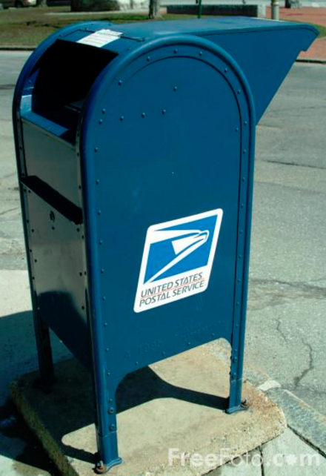
Blind Drop
Windows event forwarding cannot ship file logs
Only handles native Windows events
Business requirement may require no third-party agents
Can be handled by using a blind file share
Requires a single file server to have a third-party agent or PowerShell script
Share is created with write permissions only
Log files are then saved to this share

Slide 7
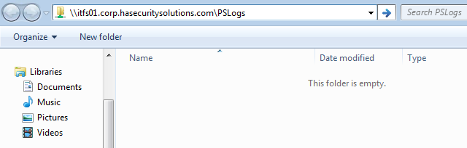
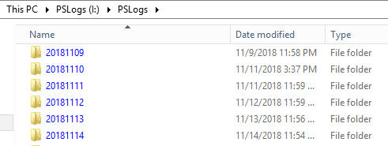

Blind Drop with PowerShell Transcription Logging
List folder contents at root folder, write only on subfolders

Slide 8
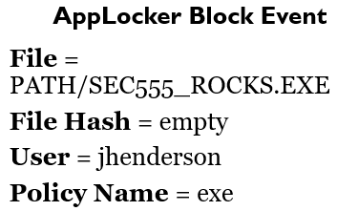
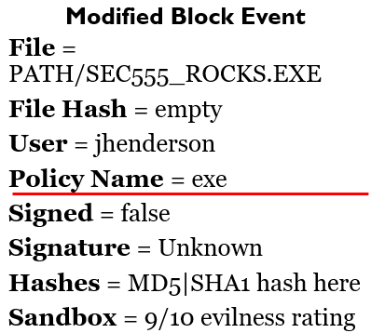
Log Collection of Key Data Source != Good Data
A SIEM is often treated as a mainstream consumer of data
Yet it should emphasize analysis and detection
Case Study / Example - Which would you rather analyze?
%OSDRIVE%\SEC555_ROCKS.exe was prevented from running.

Slide 9
Getting Context
Problem is how to gain context with a SIEM (multiple options)
Log enrichment during data ingestion (Example - Logstash)
Log enrichment while viewing the log (Example - Splunk)
Log enrichment via orchestration (Example - Phantom)
Above implementations are tool specific (use of all would be ideal)
And may be difficult to maintain / implement
Any certain techniques do not scale well with above methods
Waiting for malware sandbox analysis takes minutes

Slide 10
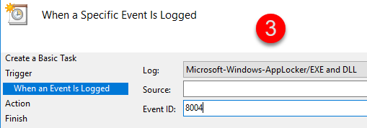
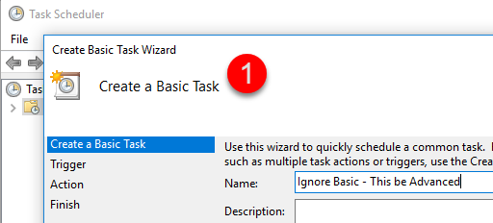
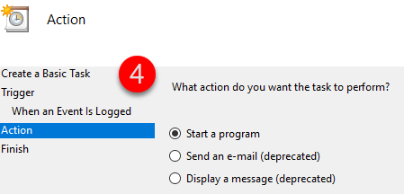
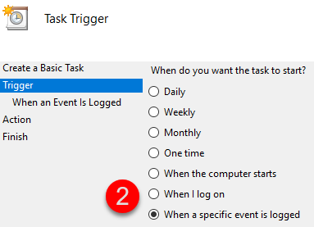
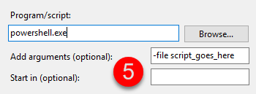
Different Approach

Slide 11
Script Logic
When task schedule is triggered the script could do the following:
Get the recent 8004 event ID from AppLocker
Send the file to malware sandbox
Run sigcheck.exe against file
See if Sysmon events exist to find parent process info
Perform any other additional checks
Write a new custom log

Slide 12
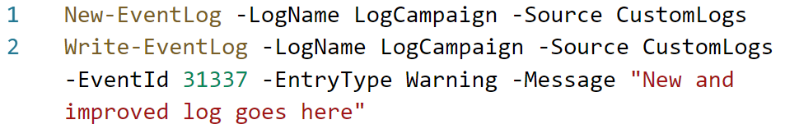
Custom Logging with PowerShell
PowerShell makes writing custom logs easy
Simply use Write-EventLog to generate a custom log
If you want a custom channel, first, use New-EventLog
Can be used to generate logs that even basic log collectors can collect
May remove the need for special log agents

Slide 13
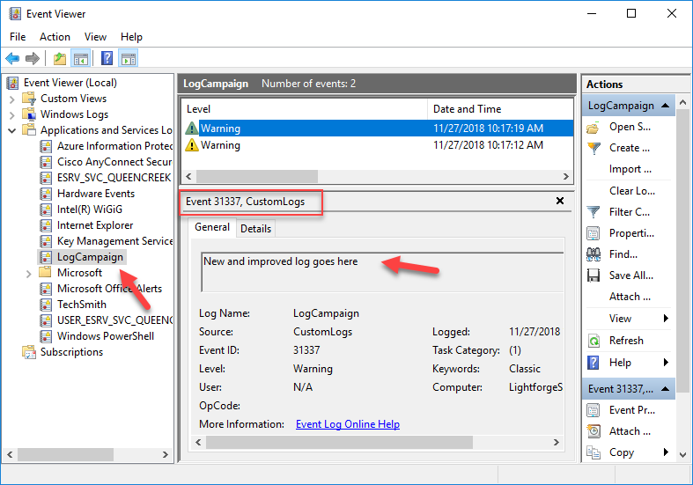
PowerShell Generated Log

Slide 14
Offloading Job
Standard user privileges work with writing logs to Windows
But custom channel must be created first
Does not work to pre-built channels like Security
Crafting log over network works as standard user
Possible to offload sensitive jobs off endpoints
Example - Trigger custom log and copy file to blind share
Then perform automated analysis there
Use SIEM to trigger automatic action

Slide 15
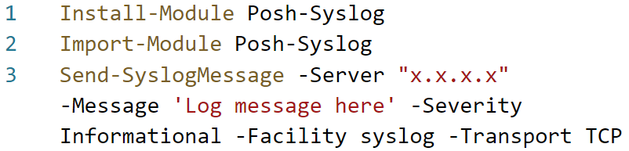
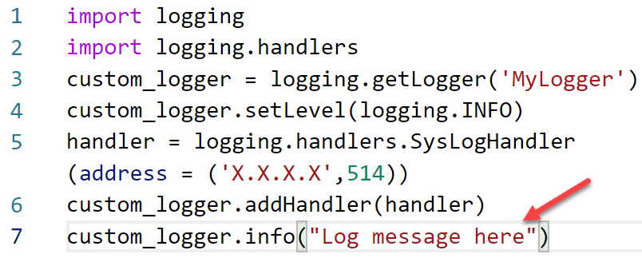
Custom Logging via Scripts
PowerShell
Python

Slide 16
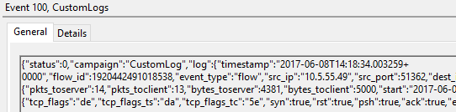
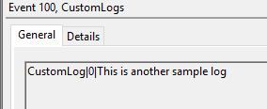
Custom Format
Scripting log allows output to be in any format
CEF
LEEF
Syslog
JSON
Key-value
CSV

Slide 17
Unconventional Logging
Collection
Enrichment
Multiple options outside of using agents to collect logs
Script out / to Windows events
Use script to send logs via syslog or custom formats
Output as file to central file share
Use Windows Event Forwarding
Take existing logs and make them better
Windows Task Scheduler
To kick off script based on Windows Event ID
Or read log with script
Then generate better log(s)
* Still need aggregator, search, and SOAR for other enrichment

Slide 18
Agentless Detection
Adversaries "live off the land" and use tools against you
But defenders need to and should "live off the land"
PowerShell, Python, and Bash provide scalable, easy to implement detection and response capabilities
Try running simple scripts on a re-occurring basis
Windows Task Scheduler running every 5 minutes
Cron job running every 1 minute
Run at startup script that handles its own scheduling

Slide 19
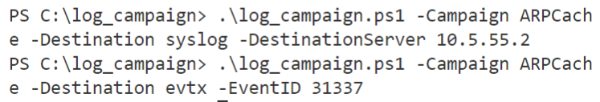
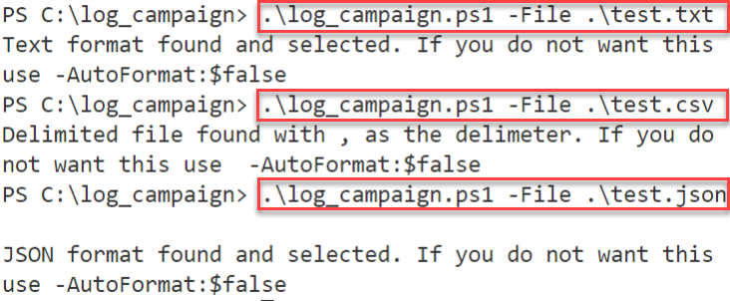
Log Campaign - GitHub Project
Provides detection capabilities with
logging
Campaigns
File Ingestion --->
Provides ability to
read in files, convert
them, and log to
syslog or evtx

Slide 20
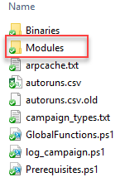
Modular Campaigns
Each Campaign is its own module
Allows easy drop in of custom modules
Or using pre-built modules
Example - ARPCache.ps1 module
On first run, saves ARP entry for default gateway
Then generates log if MAC address changes
Acts as an alert to ARP cache poisoning attacks

Slide 21
Autoruns.ps1 Module
Campaigns can call 3rd party binaries like autorunsc.exe
Many organizations use autorunsc.exe for incident handling / forensics for finding persistence
Works well for local or file server storage but not daily baseline to SIEM (or near real time monitoring)
Autoruns.ps1 module calls autorunsc.exe
Generates logs only when new or changed entries found
Can be run every X minutes without your SIEM dying

Slide 22
Baseline Data Sources
Good data requires getting your hands dirty
May have to go "fetch" what you need
Useful data
Active processes
Certificates
Drivers
Host files
Registry keys
Route table
Scheduled tasks
Security status
Services
Shares
Software
USB devices
Users and groups

Slide 23
Log Campaign - Scheduling
Log Campaign supports multiple methods of scheduling
Control schedule via Windows Task Scheduler
Implement schedule using -Schedule parameter
Supports per X minute repetitive scheduling
Great when combined with a startup task or script
Run all Campaigns or specific ones on custom schedules

Slide 24
Local Detection Strategies
Matching (Blacklist) - Look for something that should not occur then generate alert
Anomaly - Look for things that change
To save time and resources consider only sending "new" items
Change Monitoring - Look for things that change
Treat as alert if change is not authorized / expected
Local use can be combined with things like DeepBlueCLI
Any tool that can output to file may be easier to maintain

Slide 25
GitHub Link
Log Campaign can be found in this GitHub repo:
https://github.com/HASecuritySolutions/LogCampaign
Feel free to modify or make a Python or Bash equivalent

